Slide 1
Key drivers for this work
MPT&E is transforming the way it operates to enhance and optimize the Navy’s ability to attract, recruit, assign, train and retain the best Sailors now and in the future​.
Currently, the Navy has about 55 legacy environments that will undergo IT Transformation to become one “Single System of Systems.”
ADE 2.0

Slide 2
To-Be: Single System of Systems
DATA ELEMENT LOAD
Single Point Entry
Data Elements: Ship info, pay grade, rates, ship type, stakeholders, etc
Information Sourcing
Pay rate and grade information is available to determine proper pay during deployment. FMRD calculates requirements per a sailors level and pay.
Navy Personnel & Pay
1
MPT&E CORE
Education and experience information is available to determine proper training and availability for fleet. FMRD determines production and idle time per experience and education.
Learning Stack
2
Customer Relation management
3
ADE 2.0
4

Slide 3
FMRD Future State Process
Approval
YES
Information Delivery & Consumption
APPROVER
NO
Ship Support
YES
ANALYST/SPVSR
Ship Maintenance
Information Delivery & Consumption
Reports are analyzed and submitted via workflow.
NO
Ship Production
ADMIN
Corrections are made to documents rejected and resubmitted.
Document prep
Information Sourcing
4
ADE 2.0
STAKEHOLDER DATA ELEMENTS
Data
Stakeholder data is extracted and uploaded to ADE.
Distribution of reports to stakeholders
Stakeholders
Data

Slide 4
FMRD Future State Afloat Process
Information Delivery & Consumption
CM
Information Delivery & Consumption
Data generated from MPT&E Core and stakeholders
PM
Information Delivery & Consumption
OUS
Approval
YES
Stakeholders
APPROVER
NO
Ship Support
Information Delivery & Consumption
YES
Data is revised and resubmitted.
Reports are analyzed and submitted via workflow.
ANALYST/SPVSR
Ship Maintenance
NO
Ship Production
4
LOAD DATA ELEMENTS
Data Elements: Ship info, pay grade, rates, ship type, stakeholders, etc
ADE 2.0

Slide 5
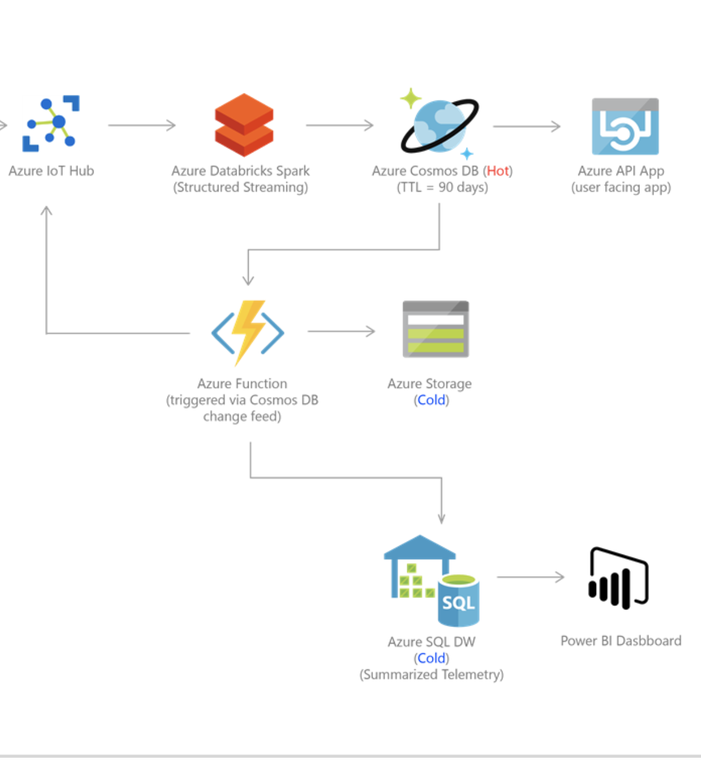

Afloat Future State Technology
Predictive Technology
Predictive Technology distributes information 20% - 30% ahead of normal machinery, equipment failure to determine faster response time and to reduce or eliminate repair delays.

Slide 6
FMRD Future State Predictive Maintenance
Predictive Afloat
Predictive Equipment / Machinery
Predictive Supply
Predictive Labor
Afloat AR / VR
EM Sensors
Food Prep/storage Sensors
Human Sensors
• Watches providing sleep, motion activity, blood pressure information to be logged in daily.
• Augmented Reality / Virtual Reality technology will provide afloat monitoring in real-time to man- the- ship.
• Sensors providing real-time usage data of equipment and machinery information.
• Sensors providing real-time usage data of food prep, storekeeping information.
Predictive Afloat Analysis Report
• Total ship manning monitoring
• Afloat checklist on manning
• Normal / issue comment
• Fuel consumption
• Future evolution/mission requirements
Predictive EM Analysis Report
• Total ship lifetime work hours
• Total ship usage hours
• Normal maintenance %
• Normal failure %
Predictive Supply Analysis Report
• Total supply
• Supply tracking
• Food temperature/spoil tracking
• Total spoilage hours
• Normal spoilage %
Predictive Labor Analysis Report
• Total sailor work hours
• Total ship productive/idle hours
• Normal productive/idle %
• Normal failure indicators
• Environmental factors (heat stress/hearing conservation)

Slide 7

FS Predictive Afloat
Predictive Afloat
Predictive Afloat
simplifies the analysis of the entire ship(s) using Augmented Reality / Virtual Reality technology to:
• Reduce time to man-the-ship
• Increases time to research afloat issues
• Reduces manning hour fatigue
• Reduces incidences during manning
• Share/support with other ships virtually
• Future events/evolutions preparation
Afloat AR / VR
• Augmented Reality / Virtual Reality technology will provide afloat monitoring in real-time to man- the- ship.
Predictive Afloat Analysis Report
• Total ship manning monitoring
• Afloat checklist on manning
• Normal / issue comment

Slide 8
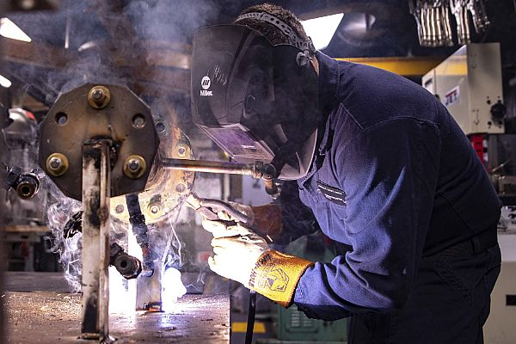
FS Predictive Equipment / Machinery
Predictive Equipment / Machinery
Predictive Equipment / Machinery (EM)
simplifies the analysis of EM by using sensors to:
• report real-time EM activity
• report 20%-30% maintenance or repair levels
• Significantly reduce or eliminate repair delays
• Provides for Smart scheduling
EM Sensors
• Sensors providing real-time usage data of equipment and machinery information.
Predictive EM Analysis Report
• Total ship lifetime work hours
• Total ship usage hours
• Normal maintenance %
• Normal failure %

Slide 9
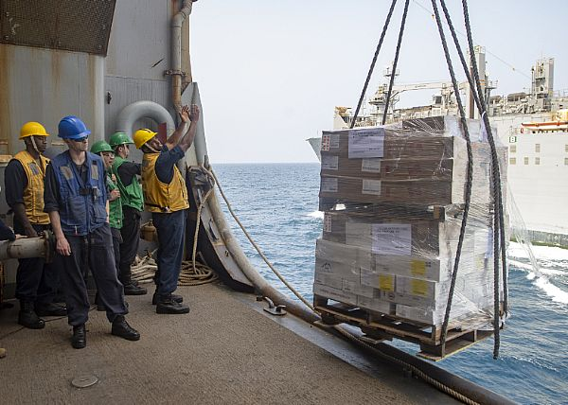
FS Predictive Supply
Predictive Supply
Predictive Supply
simplifies the analysis of supply by using sensors to:
• report real-time supply levels
• detect subtle spoilage for perishable items
• Significantly reduce or eliminate supply waste
• UIC code tracking
• Provides for Smart scheduling
Food Prep/storage Sensors
• Sensors providing real-time usage data of food prep, storekeeping information.
Predictive Supply Analysis Report
• Total supply
• Supply tracking
• Total spoilage hours
• Normal spoilage %

Slide 10
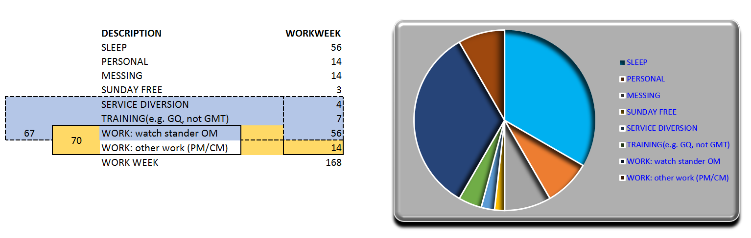
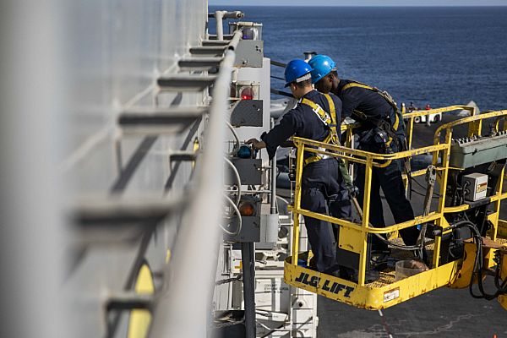
FS Predictive Labor
Predictive Labor
Human Sensors
• Watches providing sleep, motion activity, blood pressure information to be logged in daily.
Predictive Labor
simplifies the analysis of EA’s and CF’s for:
• fatigue for productivity/idle.
• latest technology for sleep hours, pedometer, heartrate and exercise
• Environmental risks to sailor (heat/noise)
Predictive Labor Analysis Report
• Total sailor work hours
• Total ship productive/idle hours
• Normal productive/idle %
• Normal failure indicators
Predictive Training gathers MPT&E CORE: Learning Stack data to fill qualifications, Condition I, III Readiness and determines continuous training requirements afloat.

Slide 11
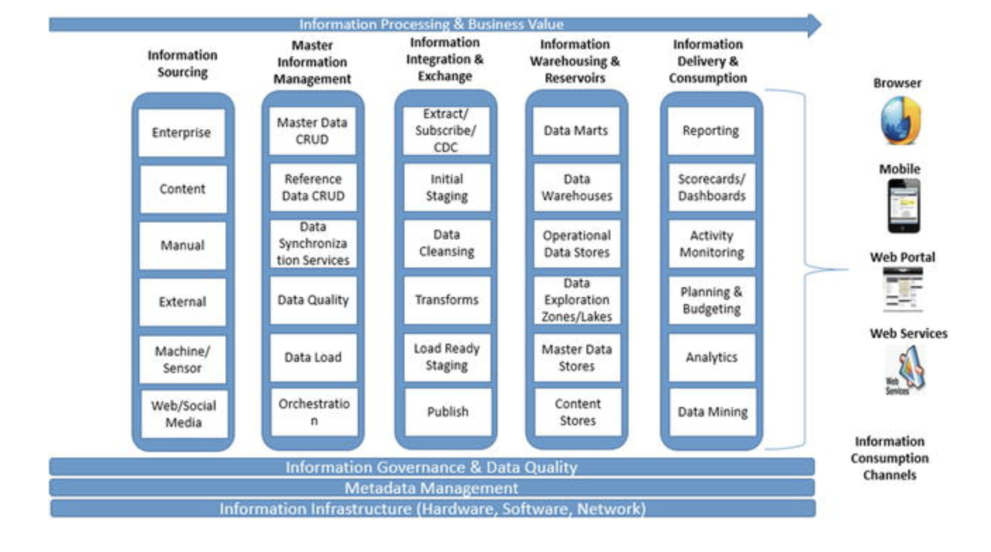
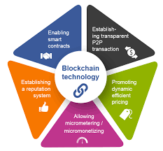
FS Blockchain Technology
Blockchain is digital pieces of information stored into multiple blocks strung together where transactions occur and are verified given a unique identifying code called a hash, which is updated automatically.
• Unlimited recordkeeping with impossible tampering capabilities
• Great user privacy and security
• Highly efficient
• Supplier-friendly for recording origins of materials purchased
• Maintain transparency
• Smart contract computer code capabilities to facilitate, verify to a set of conditions that users agree to.
Current State Afloat Process
Blockchain

Slide 12
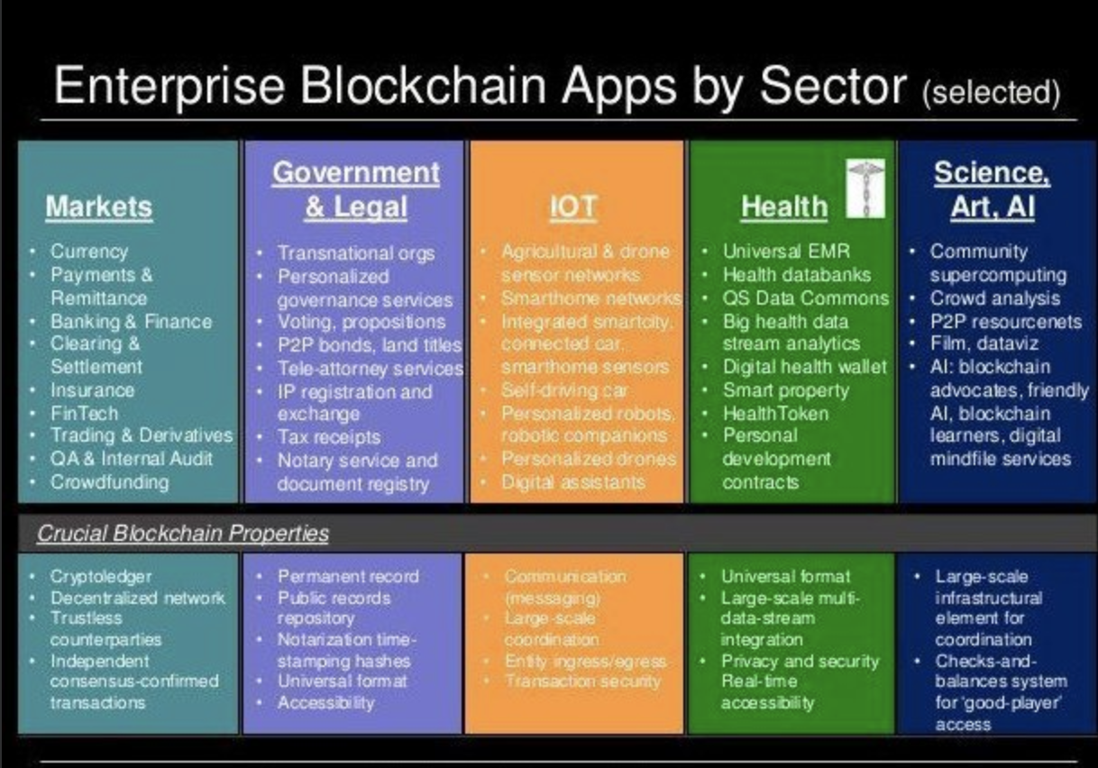
FS Blockchain by Sector

